Slide 1







Open-Source Intelligence (OSINT) Week 10: By Oracle

Slide 2




What is OSINT?
Open Source Intelligence (OSINT) is gathering information from publicly available sources for security purposes.
Relevance in Cybersecurity: Critical for threat intelligence, vulnerability assessments, penetration testing, and incident response.

Slide 3
Use Cases
Tactical Threat Analysts may use OSINT to conduct intelligence operations, gathering information on adversaries that may target their organization.
Security Analysts will use OSINT data for several reasons, such as checking the reputation of IOCs such as IP addresses, email addresses and file hashes. Other use cases could include investigating fake social-media accounts that are being used to launch social engineering attacks against employees.

Slide 4
Use Cases
Vulnerability Analysts uses OSINT to keeping up to date with the latest publicly-announced vulnerabilities, following vulnerability researchers on social media, and sharing information is an important part of the work these guys do.
Offensive security specialists will use OSINT to gain information about their target company, such as internal systems and employee information.

Slide 5



01
OSINT Intelligence Lifecycle

Slide 6
Intelligence Cycle
When dealing with an intelligence scenario, you need to take advantage of the massive amount of data at your disposal and use it to create an intelligence report that provides a clear explanation of the solutions you are looking for.
The only issue here is that intelligence reports do not grow on trees. So, you must not only identify all this data but also classify and organize it in such a way that all this data can be converted into information.

Slide 7
Intelligence Cycle
For these situations, there has always been a process of knowledge creation called The Intelligence Cycle.
This iterative model describes a series of stages and procedures that a researcher has to perform to convert the collected data and information into intelligence products capable of bringing solutions to the organization.

Slide 8
Planning and Direction
This is where you determine the purpose of your research and what kind of information you are looking for.

Slide 9
Collection
In this second phase, your objective will be identifying which processes you will use to collect such information, and then, using all the techniques you know, obtain the data that will help you carry out your intelligence operation.

Slide 10
Processing of data and information
Here your objective is not only the visualization of the information but also the application of decoding, decryption, validation, and evaluation techniques that will allow you to filter the huge amount of information you obtained, to identify useful data for your research.

Slide 11
Analysis to produce meaningful intelligence
Here you must compile all the information you filtered in the previous step to obtain the solutions to your initial problem, as well as create a coherent intelligence product (report, conference, etc.) that allows you to explain the process you recently carried out clearly

Slide 12
Dissemination of intelligence to the clients
The final step. Here you must deliver the product you developed throughout the process to the stakeholders (individuals or groups) that requested it. This will help these people make informed and appropriate decisions when tackling the original problem.

Slide 13
02
OSINT Tools

Slide 14
Theharvester Usage Example
The Harvester is a tool that was developed in Python. Using this, you can gather information like emails, subdomains, hosts, employee names, open ports and banners from different public sources like search engines, PGP key servers, and the SHODAN computer database.
This tool is useful for anyone like you who needs to know what an attacker can see about the organization.

Slide 15
Theharvester Usage Example
theHarvester -d kali.org -l 500 -b duckduckgo
Search from email addresses from a domain (-d kali.org), limiting the results to 500 (-l 500), using DuckDuckGo (-b duckduckgo)
Explore: Try using The Harvester with different domains, and different data sources.
Access the help sheet using the command theHarvester within the command line to see the data sources available, and other arguments to retrieve specific data.

Slide 16
03
OSINT Framework

Slide 17
OSINT Framework
This website, created by Justin Nordine, is a hub for hundreds of OSINT sources and tools and is easily sorted so you can find the tool that you need quickly.
You can access the site here – https://osintframework.com

Slide 18
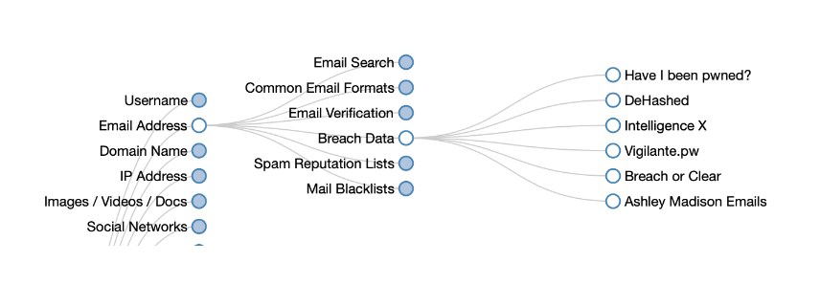
Use cases
Without being professional threat intelligence personel, we can quickly get a sense of whether a target email address has been mentioned in a data breach.
Why is this helpful, because if we get an indication that it has been leaked before, we can then start to explore paths to remedy that.
For organizations, identifying what public information, the attacker has of them or their employees is critical for reducing their threat landscape.

Slide 19


Scenerio
In this challenge, you will need to complete three objectives:
Identify any social media accounts or websites used by the person of interest
Build up a profile of the person of interest
Find any evidence of malicious behaviour

Slide 20
You work for a law enforcement organisation, and you have been assigned to track a person-of-interest, that is believed to be associated with a hacking group that recently compromised a Managed Service Provider (MSP) and are trying to sell the stolen credentials on both the clear net and dark web. Another team is focusing on the dark web lead, so you have been tasked with using OSINT sources to build up a profile on the individual and attempt to locate any evidence that links them to the MSP breach and sale of account details. You have been provided with some information to start your investigation. You should use any of the sources or tools taught in this course, that you deem to be applicable and appropriate.
Task 1

Slide 21
PS: We know that the email address used to register the Twitter account is fake, so do not include this in your report. https://d2y9h8w1ydnujs.cloudfront.net/uploads/content/files/cfd0bb8f0473f468b8c65821d633d2f118054a3356eea89b3063160f983e1ef106d66638d7d9f77cc7cea0af177b.txt
Task 1

Slide 22
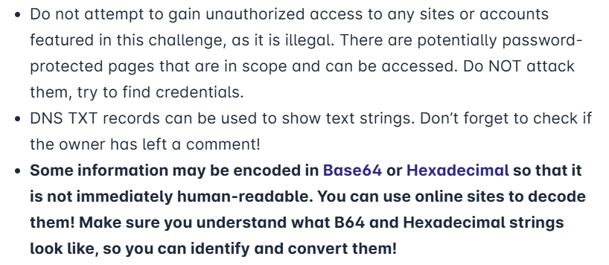
Tips and Advice

Slide 23
Select a particular coursemate in your group and perform an OSINT operation on the individual. Document as much information as you can find of the person and submit it to me. NB: Just find and document public information. Do not hack your targets. To be presented next class.
Assignment 1

Slide 24
Thanks!
Do you have any questions?
amosmarvellous48@gmail.com
+234 702 625 4613

